Slide 1
WDI Visualization
Selected Indicators Groups:
Life Expectancy
Education
Inequality
Trade
Joao Macosso 422575
Notes:
Next Slide: Life Expectancy

Slide 2
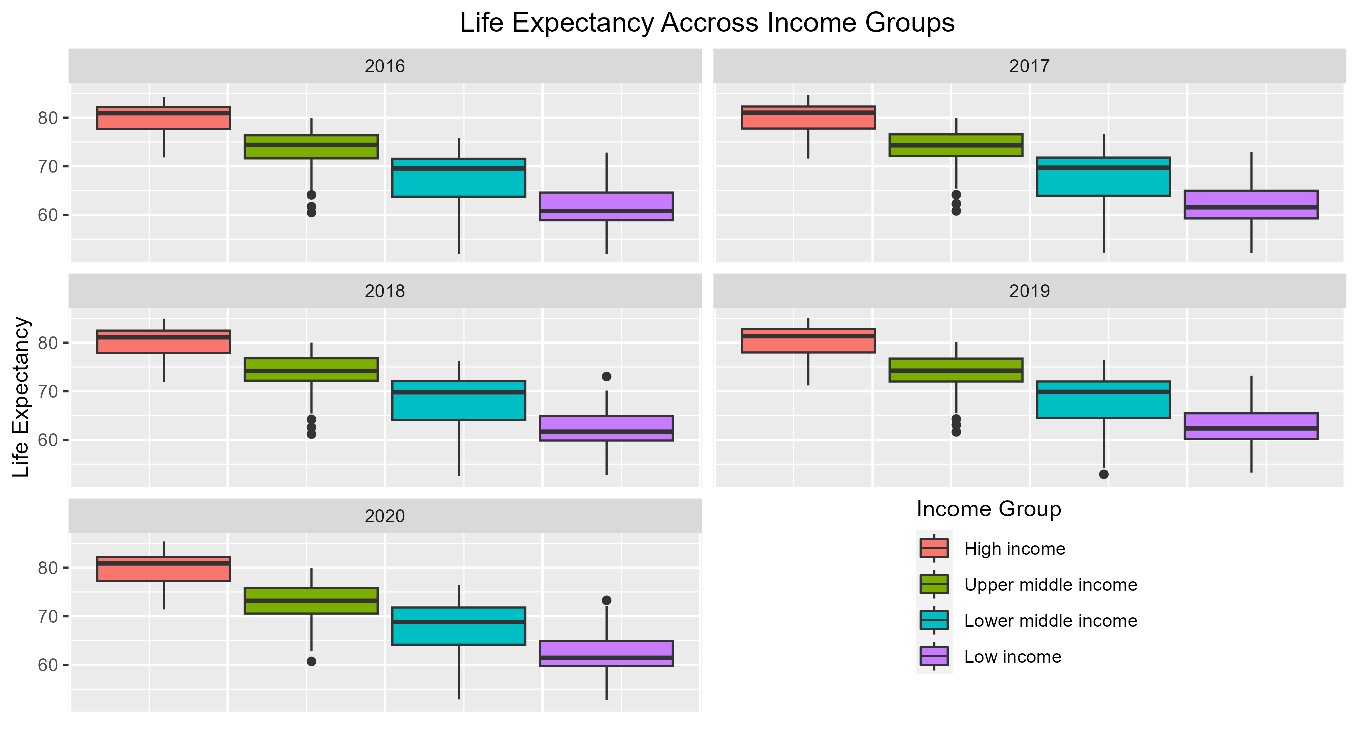

Slide 3
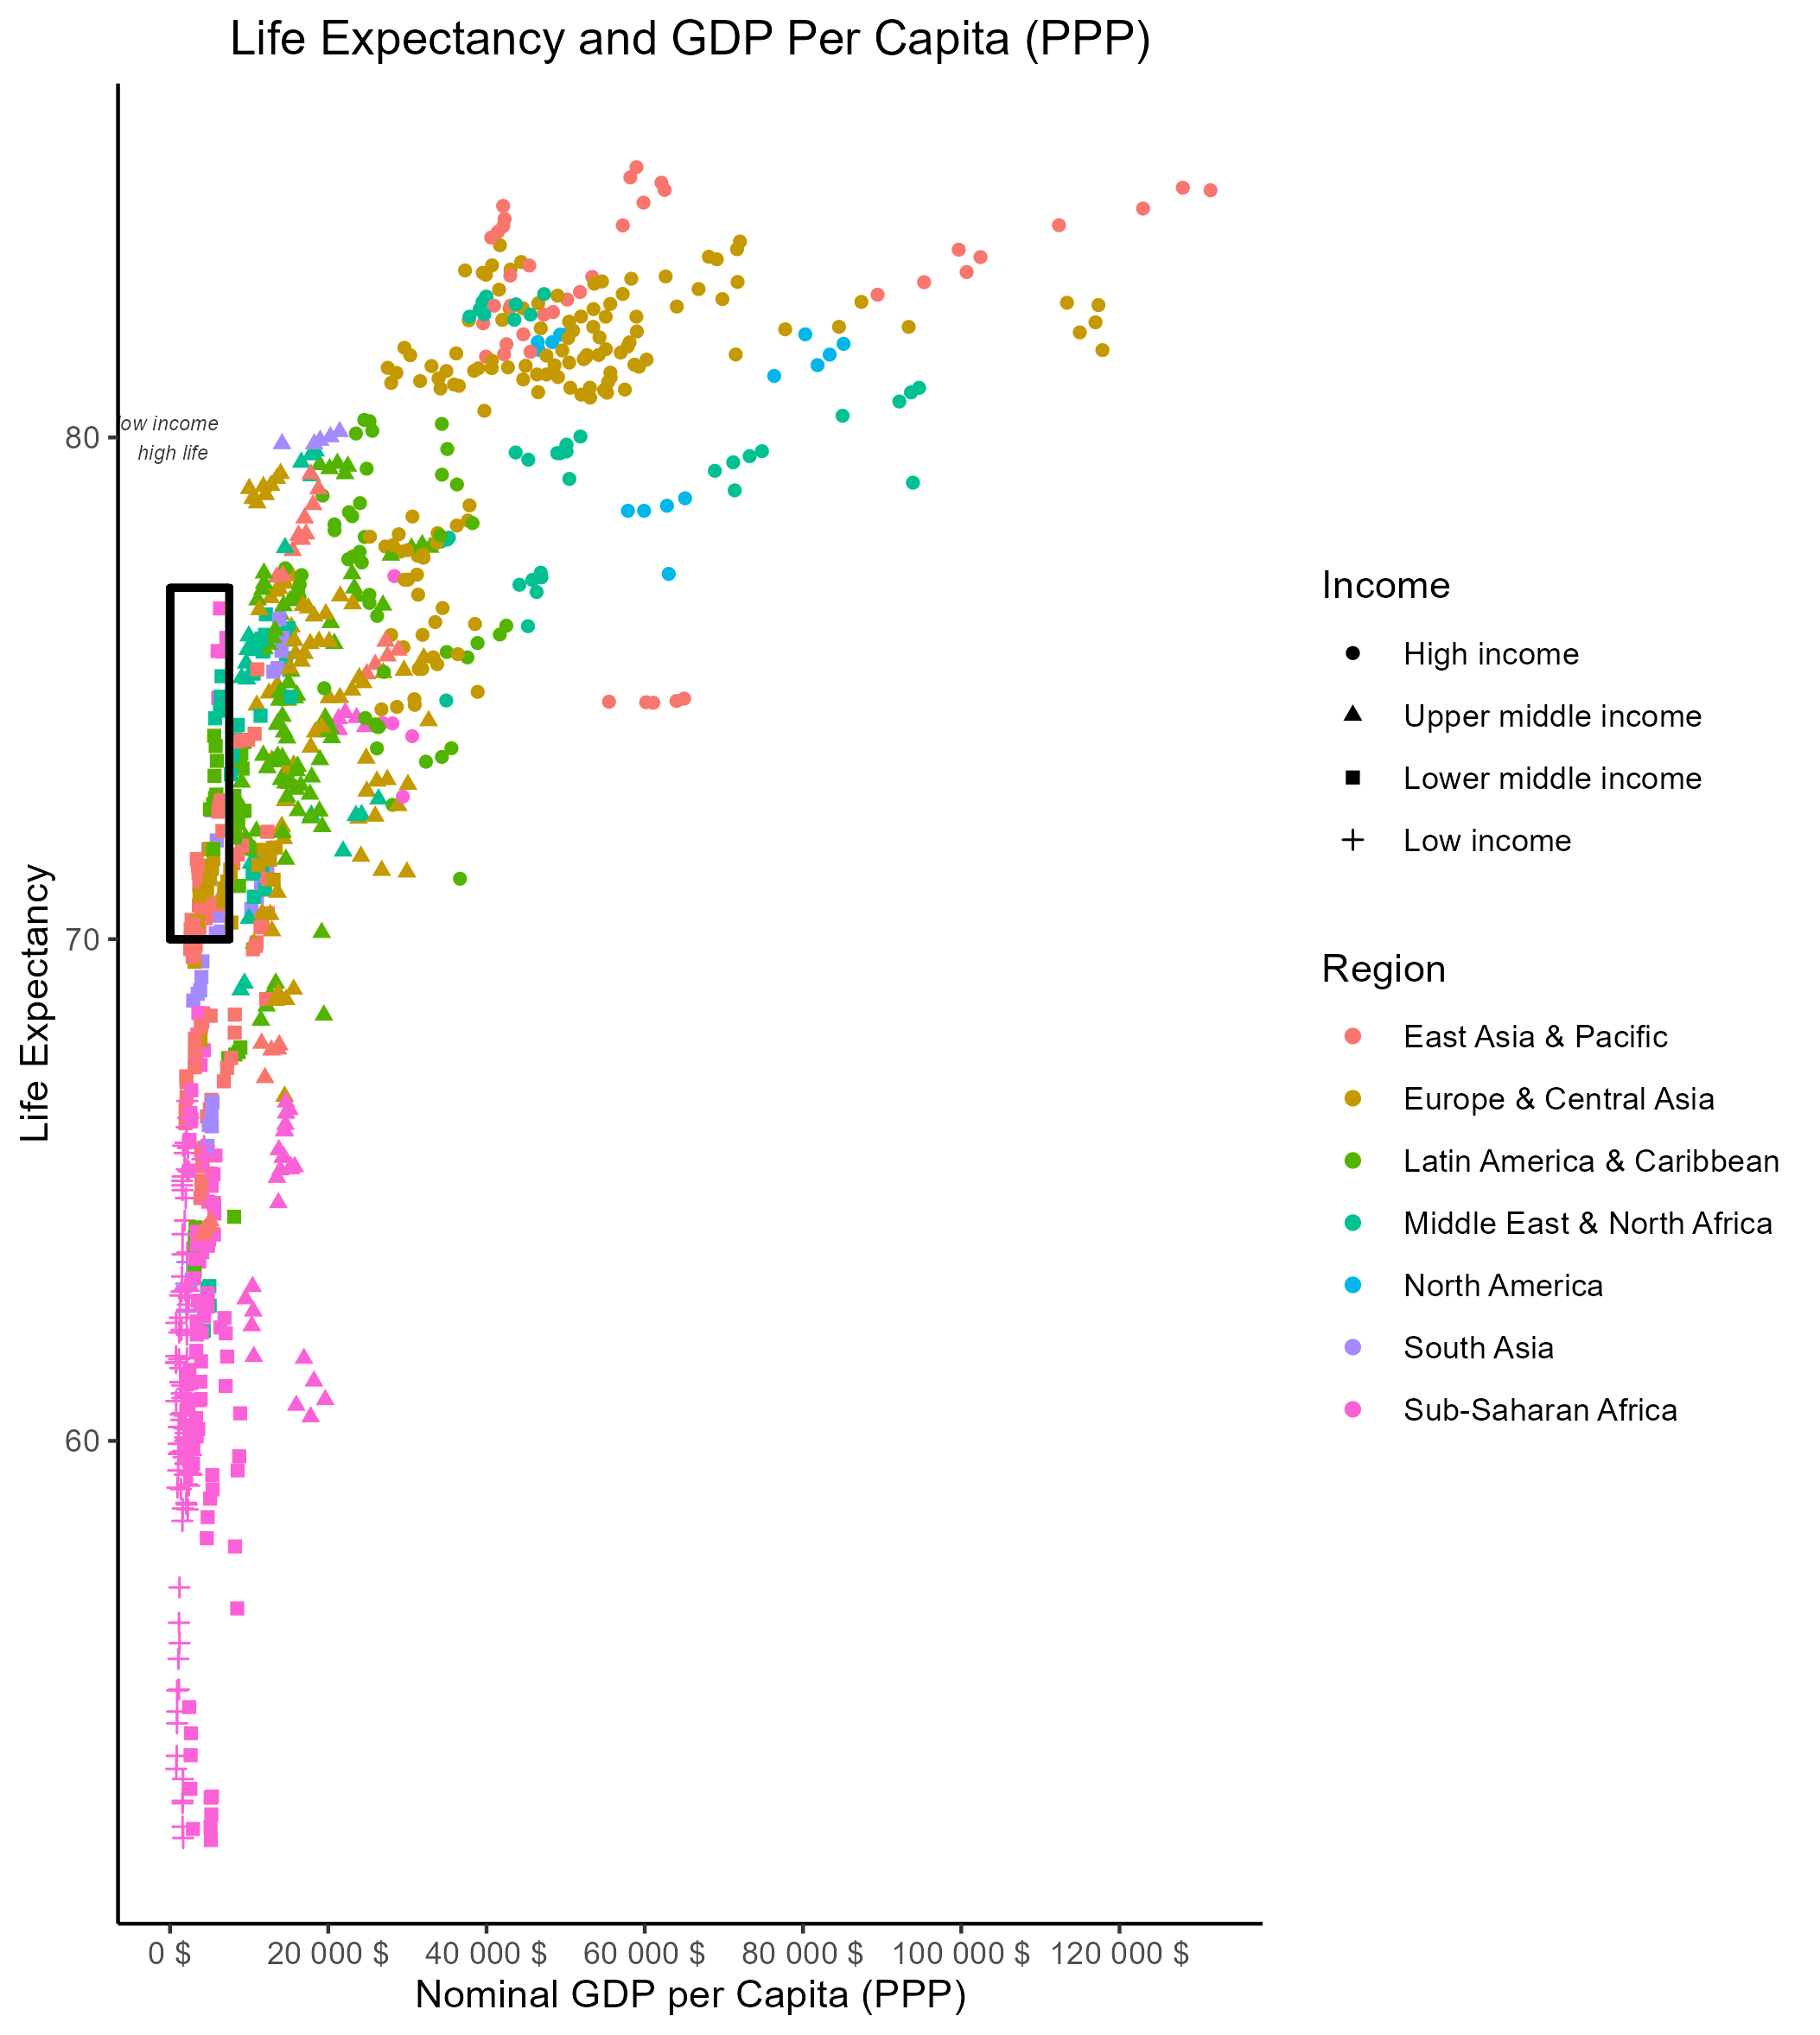
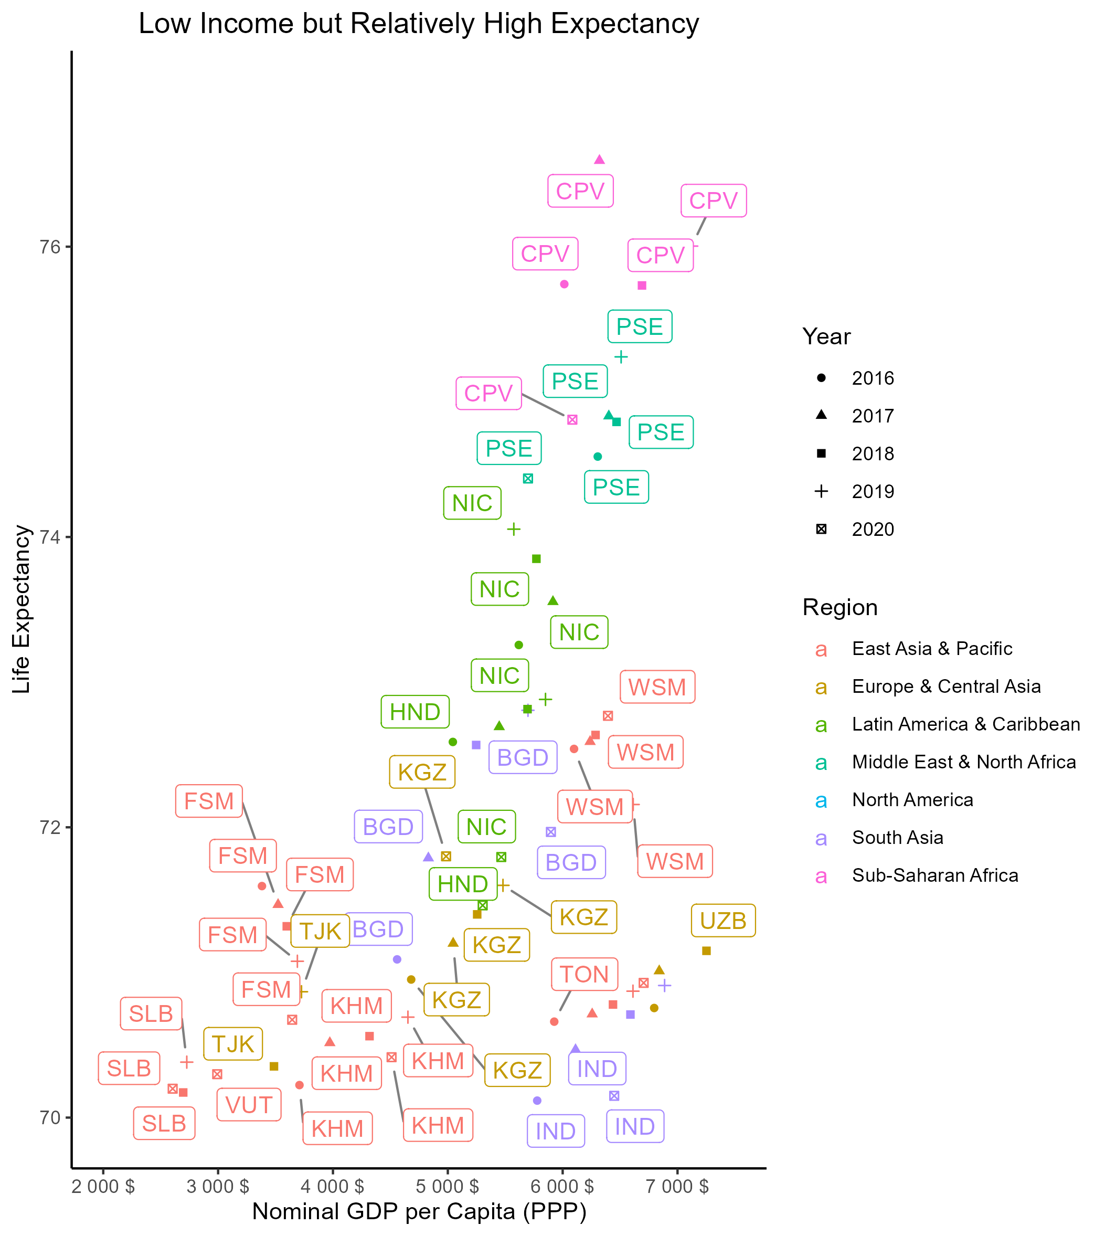
Notes:
Next Slide: Education Indicators

Slide 4
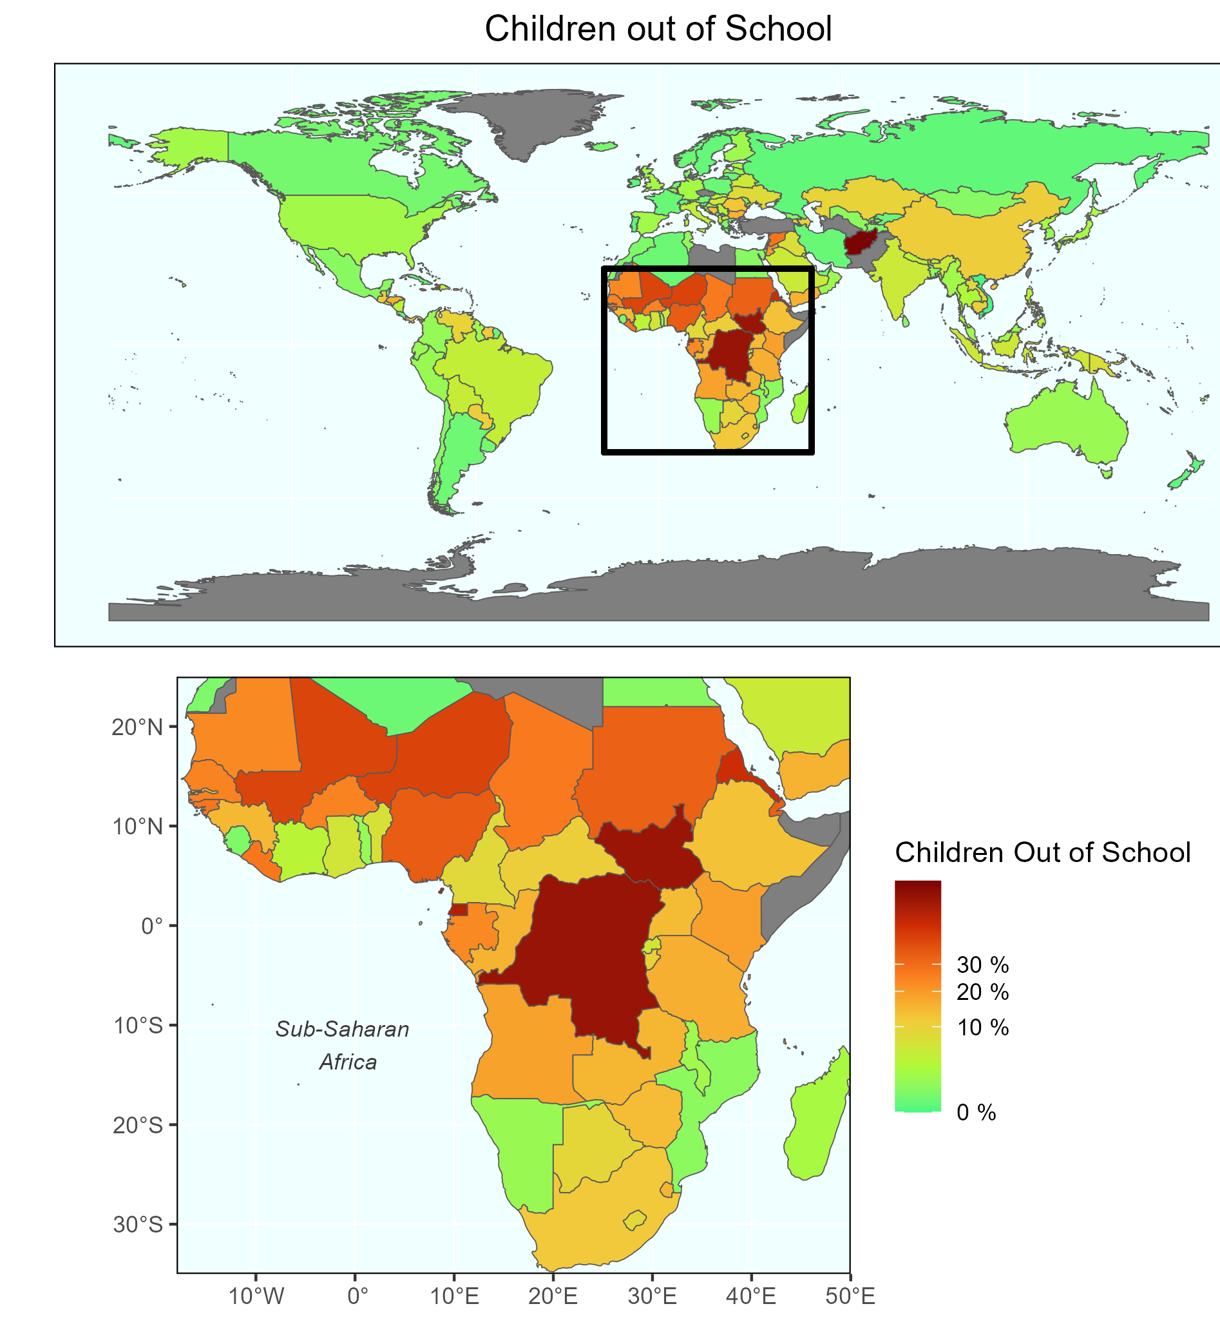
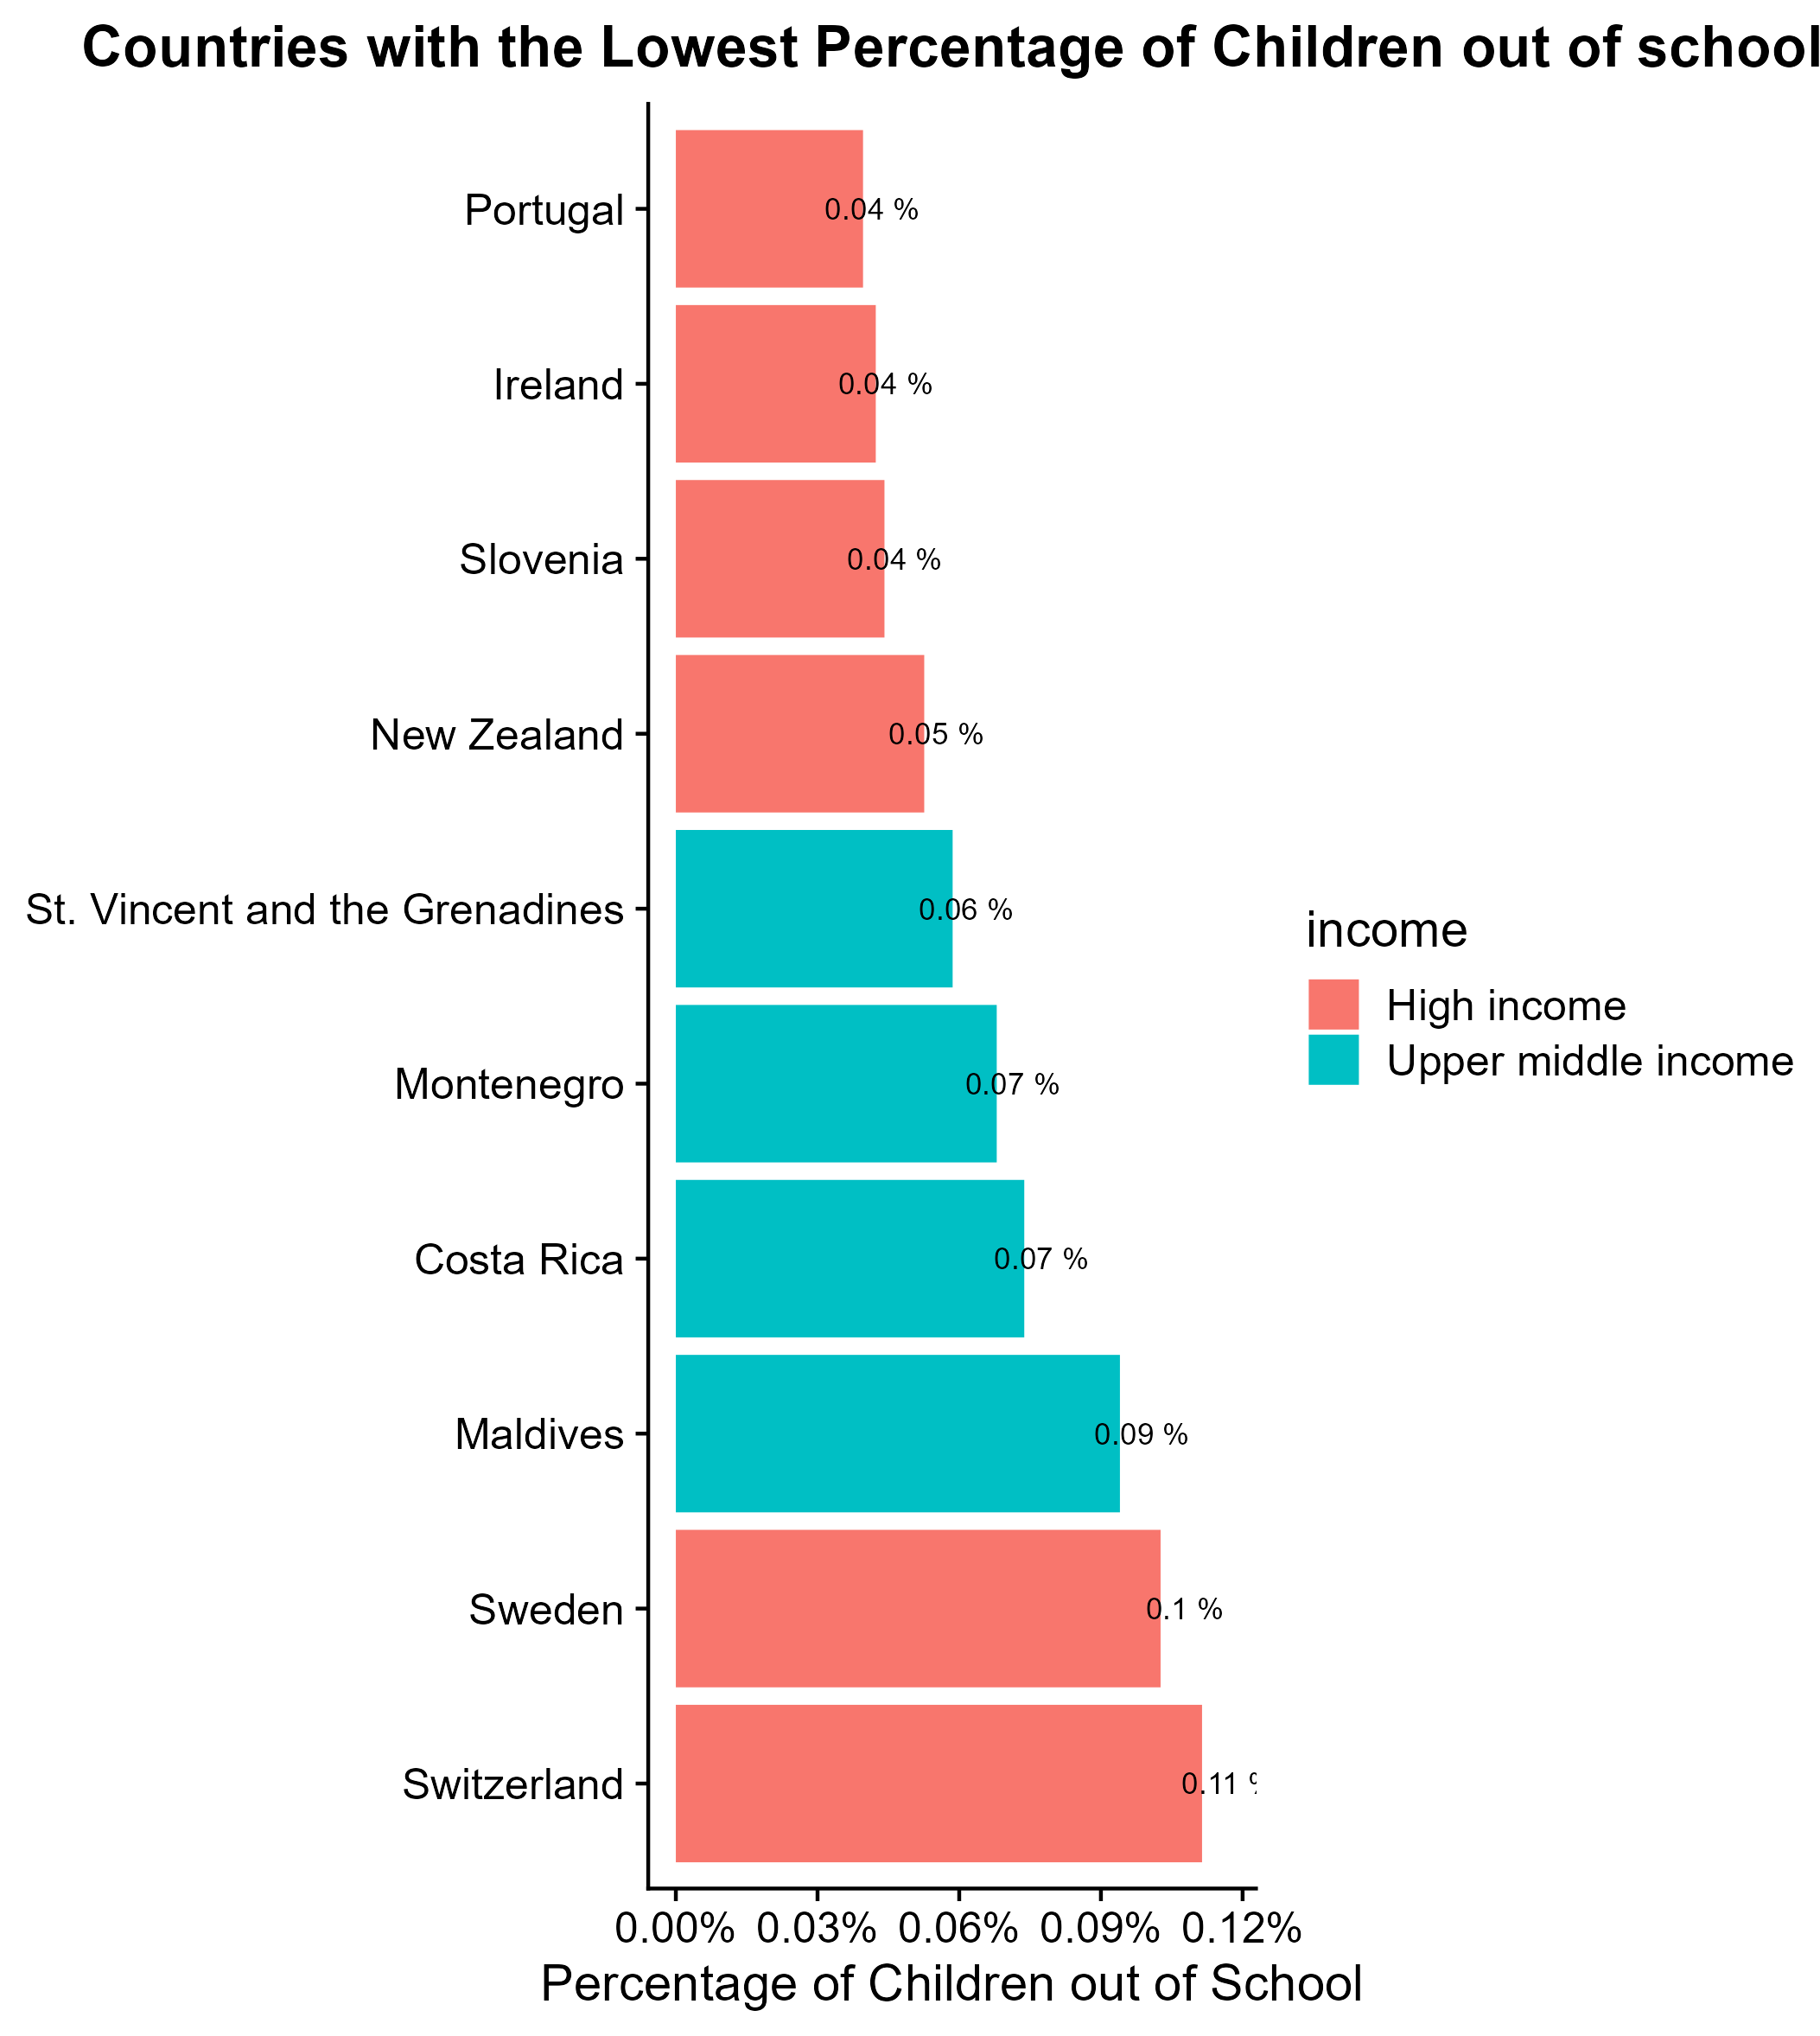
Based on Latest available data

Slide 5
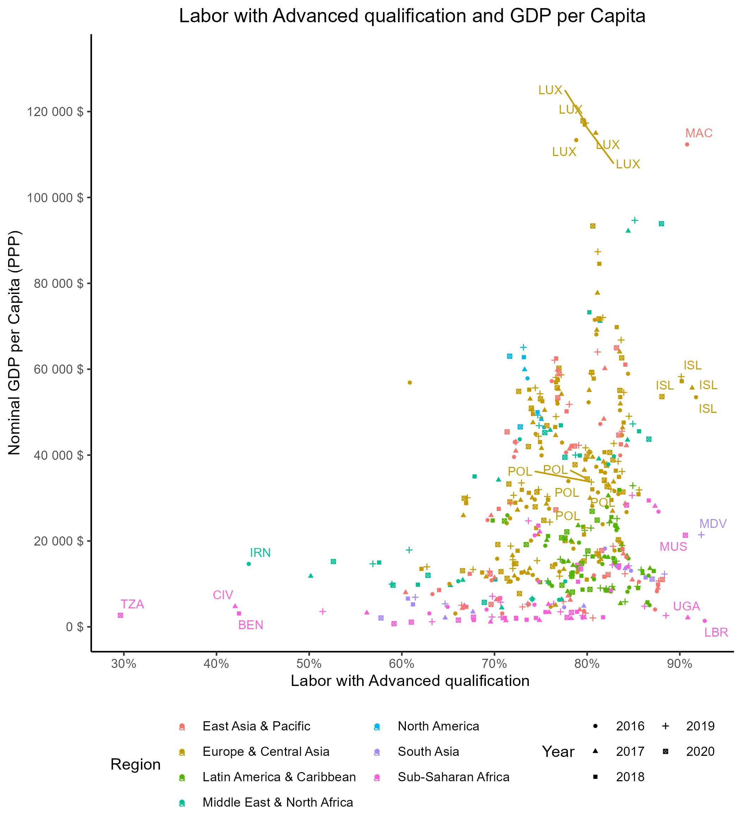
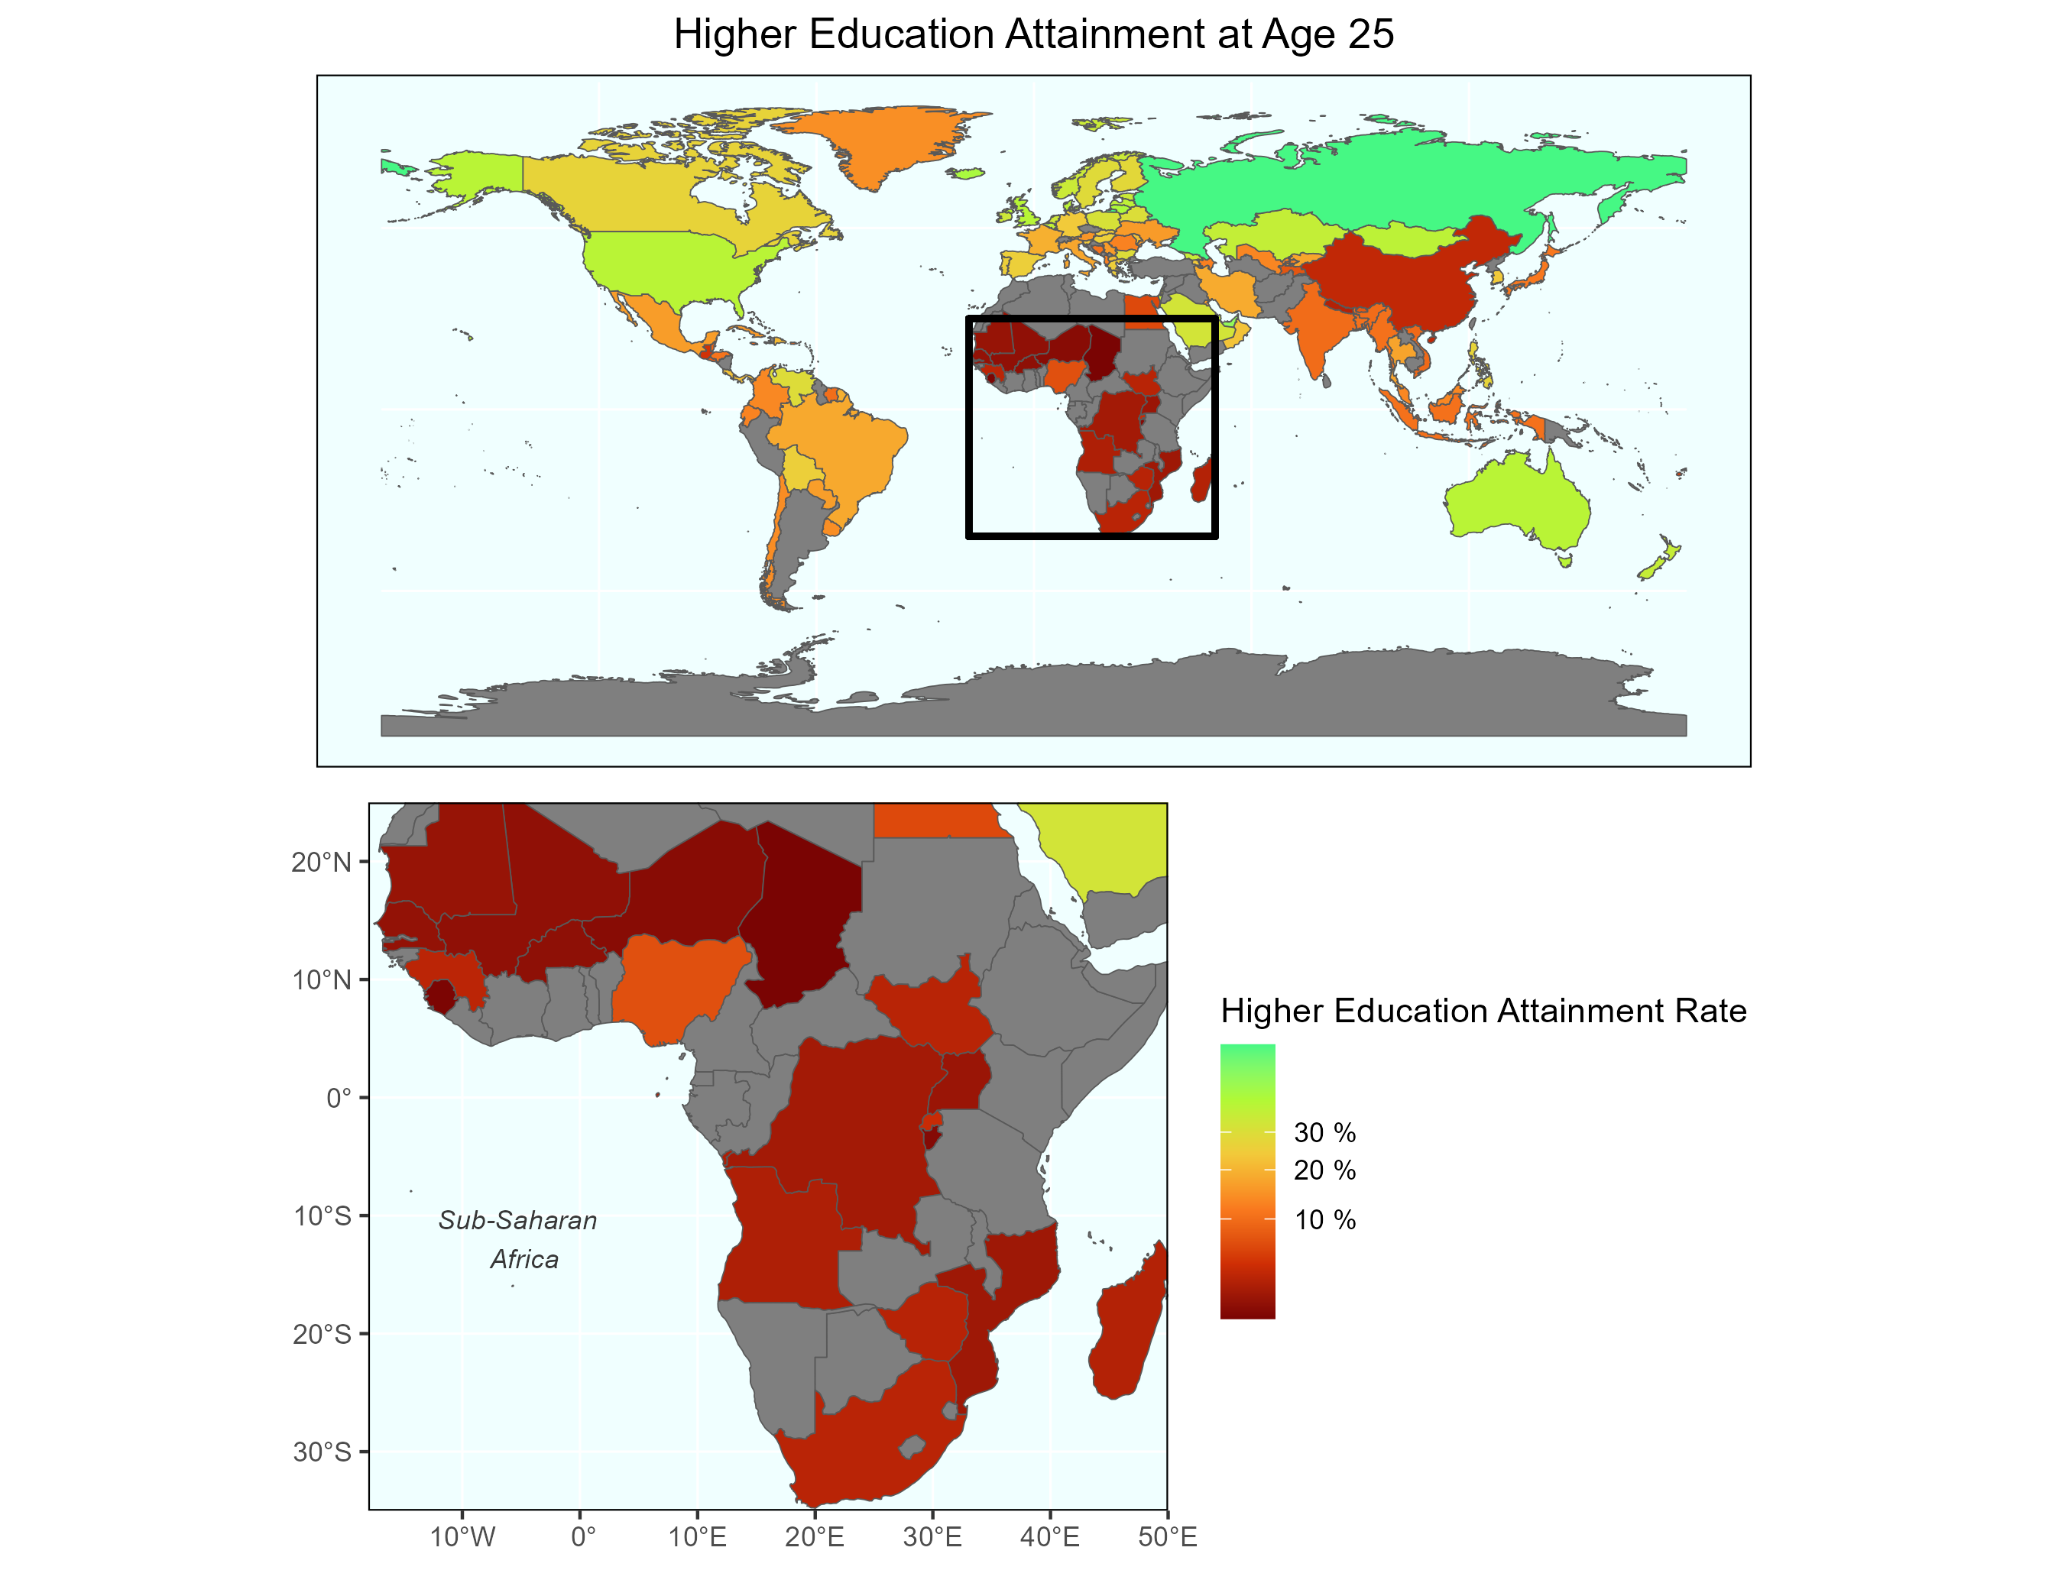
Based on Latest available data
Notes:
Next Slide: Inequallity

Slide 6
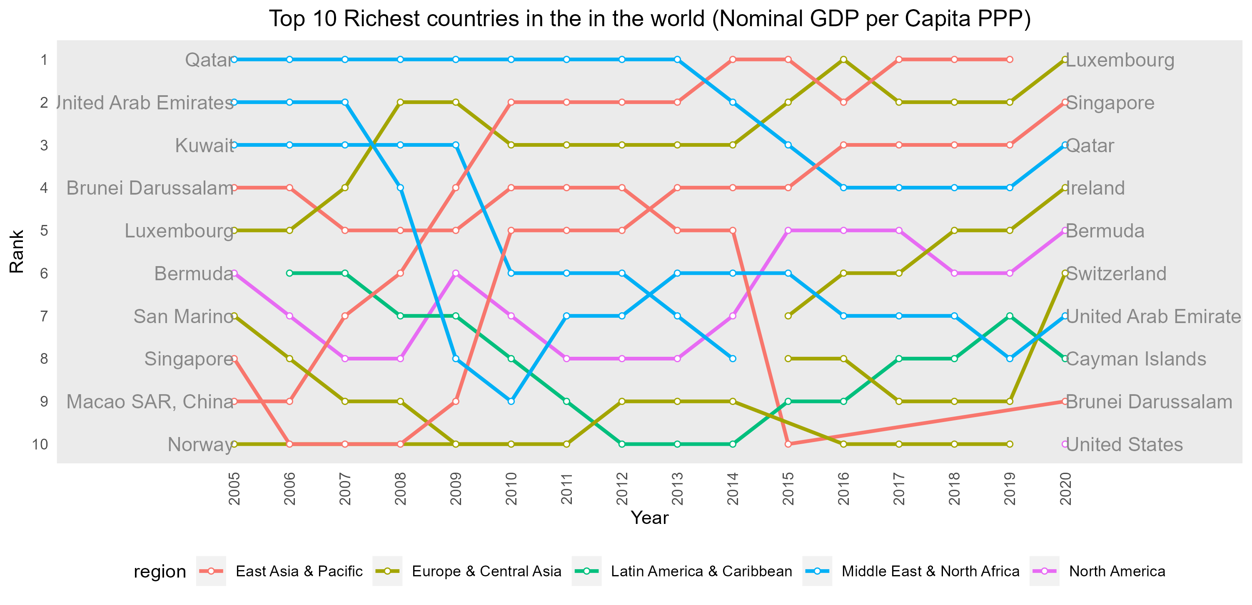

Slide 7
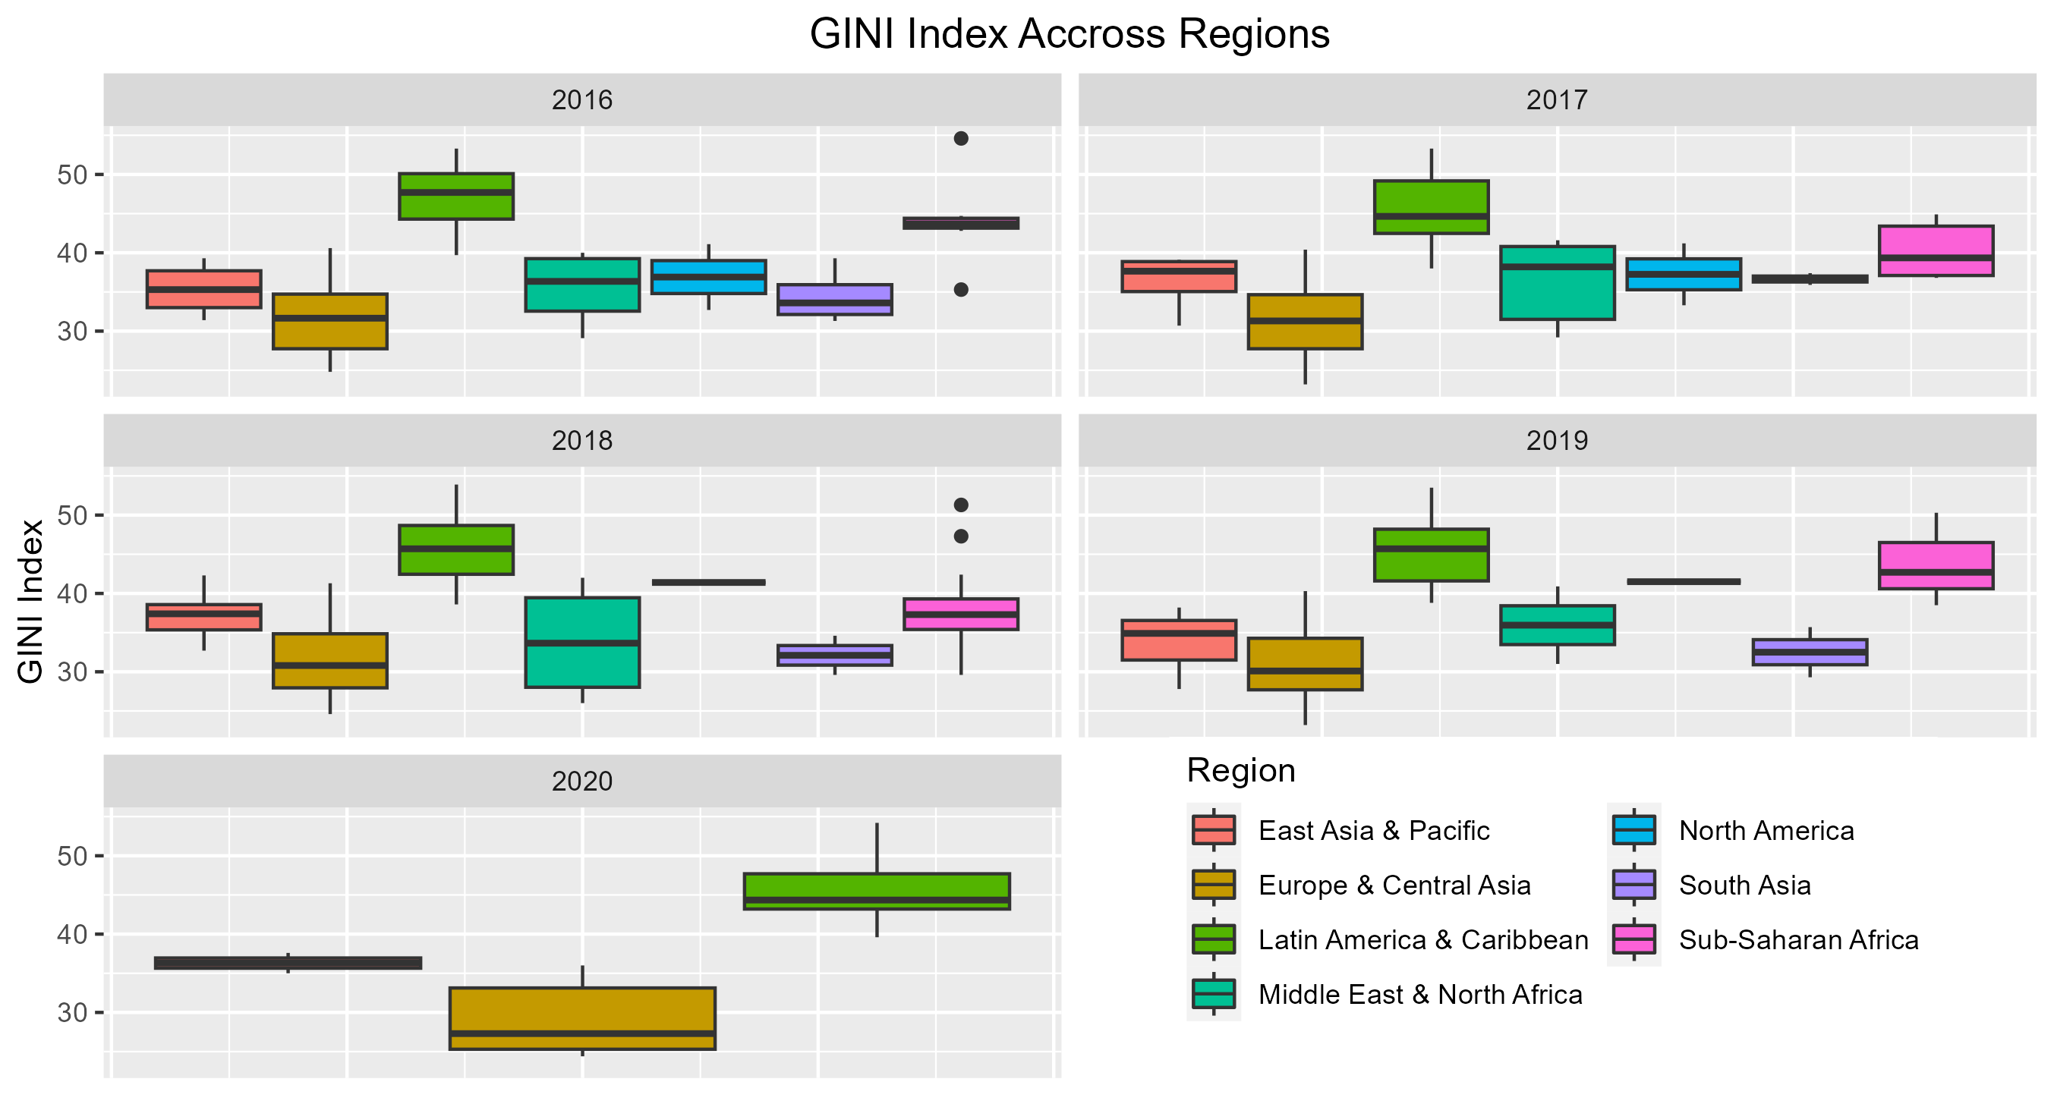

Slide 8
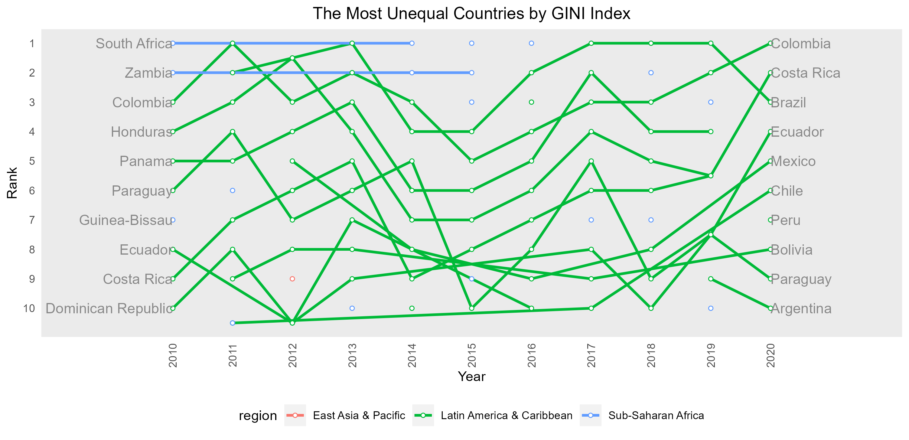
Notes:
Next Slide: Trade

Slide 9
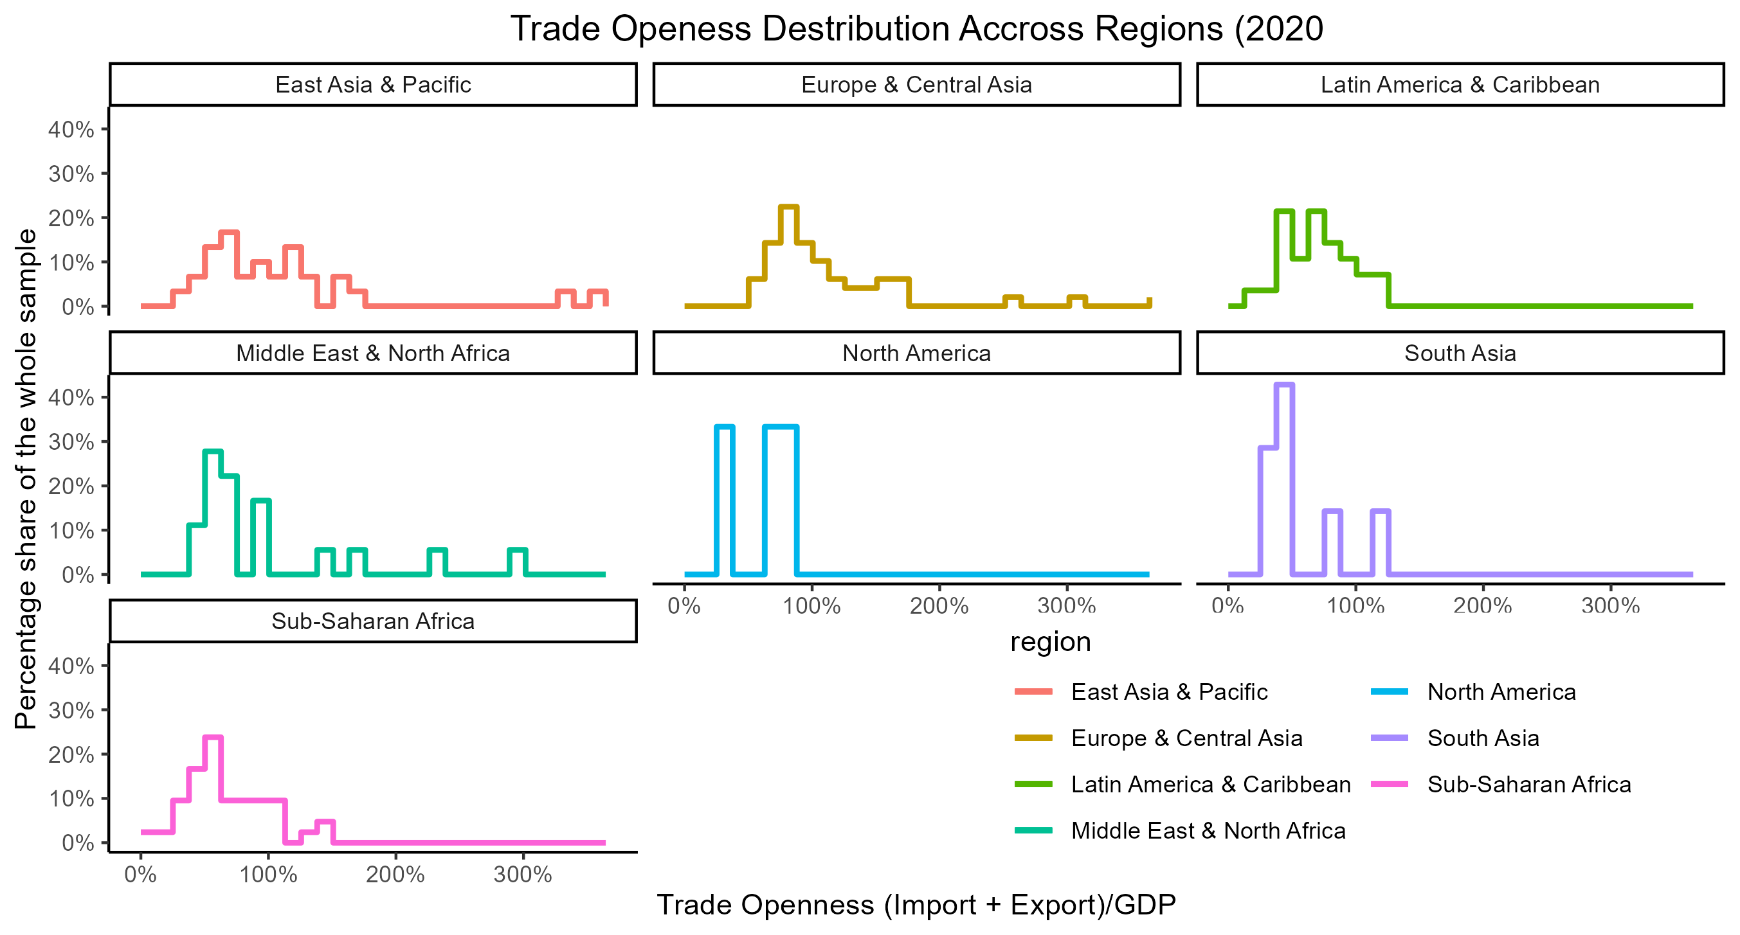

Slide 10
